Slide 1
Recommender system using svd in python March 1,2018
Notebook :
Slides by : Aditya s pawar

Slide 2
outline
Why recommendation system?
Examples of recommendation systems
Singular value decomposition (Svd)
Latent features
Evaluation of different recommendation systems
References

Slide 3
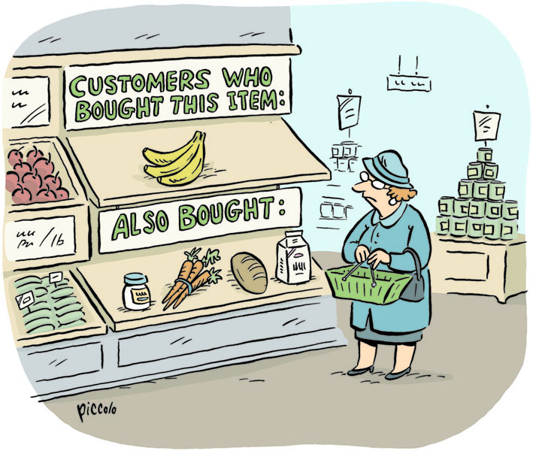
Why recommendation systems?
Goal of a recommendation system
Assist users in accessing and understanding large digital collections In domains, subject to significant personal taste
Examples
Movies/ tv Recommendations(Netflix , youtube)
Product Recommendations(amazon)
Friend Recommendations (FB)
Job Recommendations (Linkedin)

Slide 4
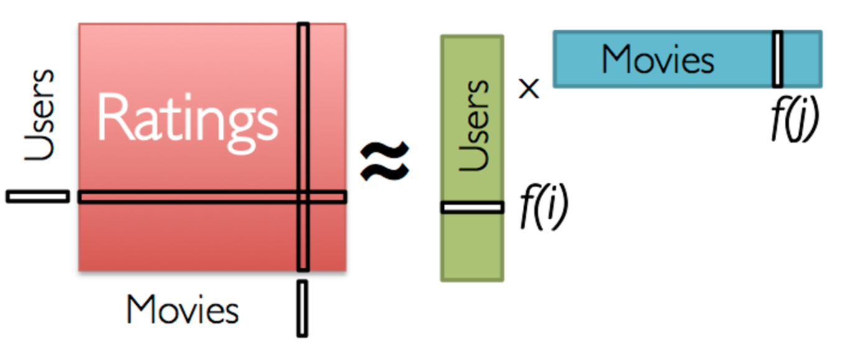
Singular value decomposition
Use Matrix factorization approaches (Singular value Decomposition or SVD) to split the Rating Matrix into constituent User Matrix and Item Matrix.
SVD:
a_{nxp}= U_{nxn} ∑_{nxp} V^{T}_{pxp}
N – User rows
P – item columns
Goal: Predict unknown ratings for the remaining set of movies using the learned User Matrix and Item Matrix

Slide 5
Latent features
SVD describes preference in terms of latent features
These features are learned from the rating data
Not necessarily interpretable
Optimized for predictive power
Defines a shared vector space for users and items(feature space)
Enables compact representation of each

Slide 6
Evaluation of different recommendation systems
 | Popularity Based | Classification Based | Nearest Neighbor based – CF | Matrix Factorization based -CF
Personal Recommendations |  | Yes | Yes | Yes
Uses Context ( Eg . time of day) | Yes | Yes
User Features |  | Yes |  | Yes
Item Features |  | Yes |  | Yes
Purchase History | Yes | Yes | Yes | Yes
Scalable |  |  |  | Yes

Slide 7
References
Coursera course on Recommender Systems, by University of Minnesota
https://www.youtube.com/watch?v=39vjrxipsxw&t=1257s (types of recommendation systems video)
http://citeseerx.ist.psu.edu/viewdoc/download?doi=10.1.1.633.1787&rep=rep1&type=pdf (A Thesis on SVD)

Slide 8
Thank you
Q/A

